Slide 1

Road Accident Analysis in India
Team - g

Slide 2
WHAT IS IT FOR?
The main objective of the project is to develop a road accident analysis system that can help to identify patterns and trends in road accidents across India.
Analysing where the problem lies and taking out important insights from the data.
Applying preventive measures to reduce Accidents in India.

Slide 3
WHAT ARE WE GOING TO DO?
We are going to analyse the data based on 5 categories and are going to take out the valuable insights out of it.
1. Reasons for road accidents in India.
2. Accident analysis by state.
3. Road accidents by weather conditions.
4. Impact of speeding on road accidents
5. Impact of alcohol on road accidents

Slide 4
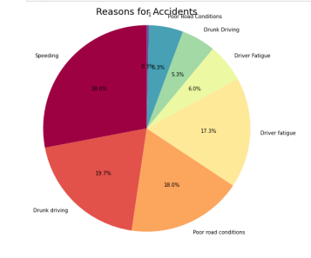
MAJOR REASONS FOR ACCIDENTS:

Slide 5
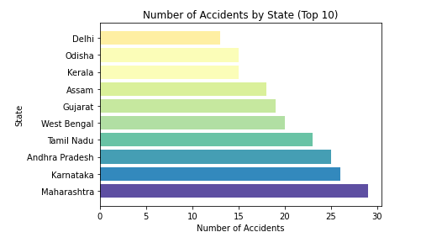
ANALYSIS OF ACCIDENTS BASED ON STATES:

Slide 6
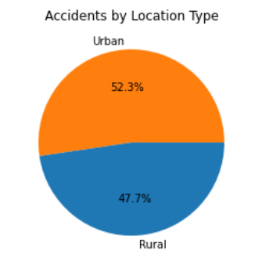
URBAN AREA VS RURAL AREA ANALYSIS

Slide 7
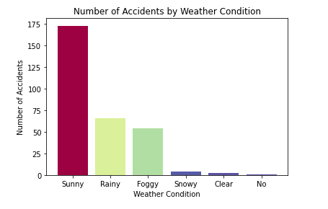
IMPACT OF WEATHER ON ROAD ACCTIDENTS

Slide 8
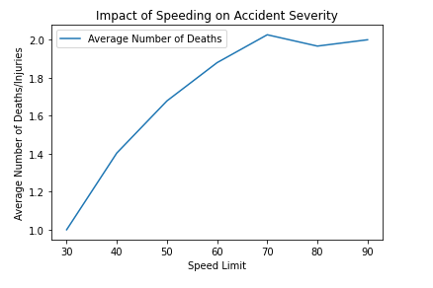
IMPACT OF OVERSPEEDING ON ROAD ACCIDENTS

Slide 9
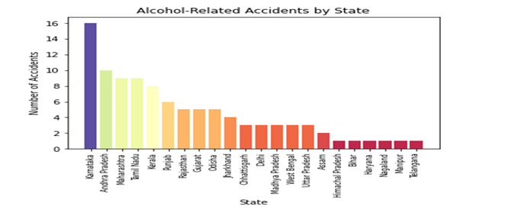
IMPACT OF ALCOHOL CONSUMPTION STATE-WISE

Slide 10
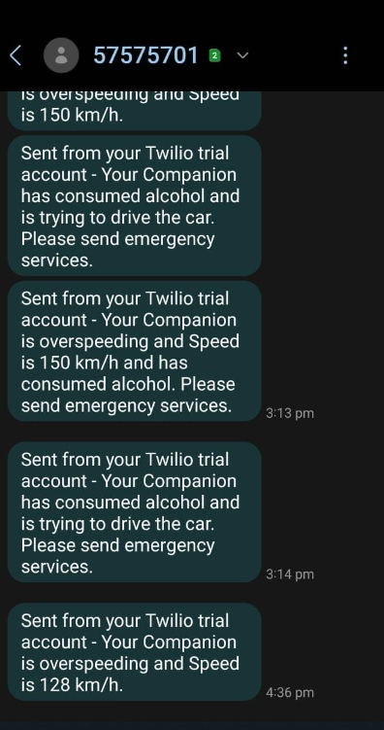
PREVENTIVE MEASURES:
TO PREVENT THE ACCIDENTS CAUSED DUE TO OVERSPEEDING AND ALCOHOL CONSUMPTION WE HAVE DEVELOPED A SYSTEM USING PYTHON TO SEND AN ALERT SMS TO THE FAMILY MEMBERS IN CASE THE DRIVER IS TRYING TO DRIVE THE CAR AFTER CONSUMING ALCOHOL OR IS OVERSPEEDING.

Slide 11
FUTURE SCOPE:
1. We can also send location of the vehicle in case if an accident takes place or if there is a case of drunken driving , if we integrate this with IoT based GPS module and Alcohol (MQ-3) sensor.
2. Develop an Android Application or User Interface to track the vehicle in Realtime using google maps API.
3. Predict the hotspot areas , where the chances of accident occurring is more and analyse what are the reasons and take preventive measures to reduce it.

Slide 12
"Road accidents are not accidents at all - they are collisions that could and should have been prevented."
-Dr. James Whalen

Slide 13
THANK YOU !
ADNAN ALI
SURESH KANTH
HARI GANESH

